Slide 1
Simulating Answers for Car Insurers
Luis Sebastian Weekes + Junaid Yeasir Fahim

Slide 2
What Do Car Insurers Want to Know?
Probabilities based on demographics?
How far do you drive?
What are your tendencies?
~AGE~
~Driving Distance~
~Speeding~

Slide 3
Bootstrap to Better Understand Car Accident Age-Distributions
Data from: The British National Archives– http://www.nationalarchives.gov.uk/doc/open-government-licence/version/3/
We really want to know the upper and lower bounds of data in particular for our simulation in the future.

Slide 4
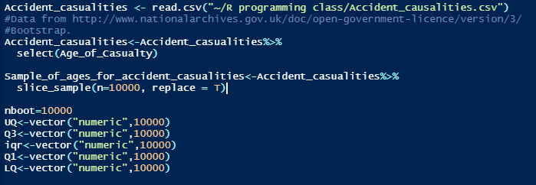
~Code~

Slide 5
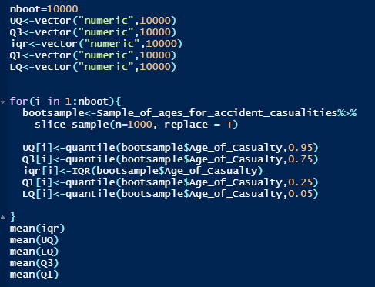
IQR ⩰ 25.6037
UQ ⩰ 70.53729
LQ ⩰ 6.789435
Q3 ⩰ 45.19535
Q1 ⩰ 19.59165

Slide 6
What is the Probability of a Person in a Fatal Car accident being under the age of 22?
Why the Beta Distribution?
Beta distribution with shape1=2 and shape2=5.

Slide 7
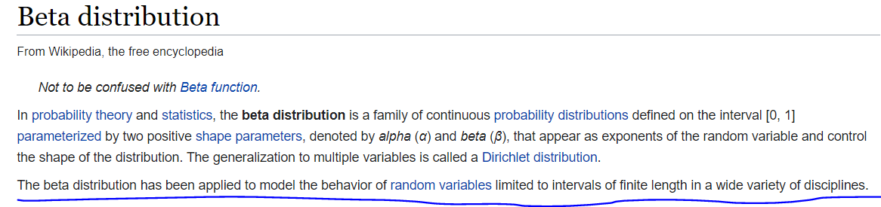
It fits the description…

Slide 8
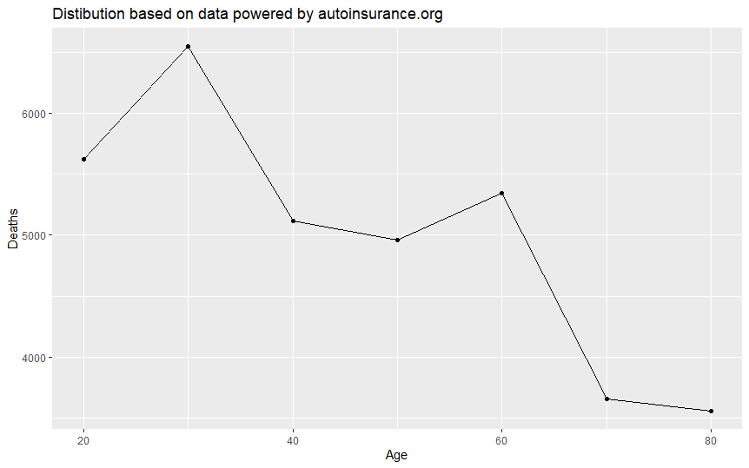
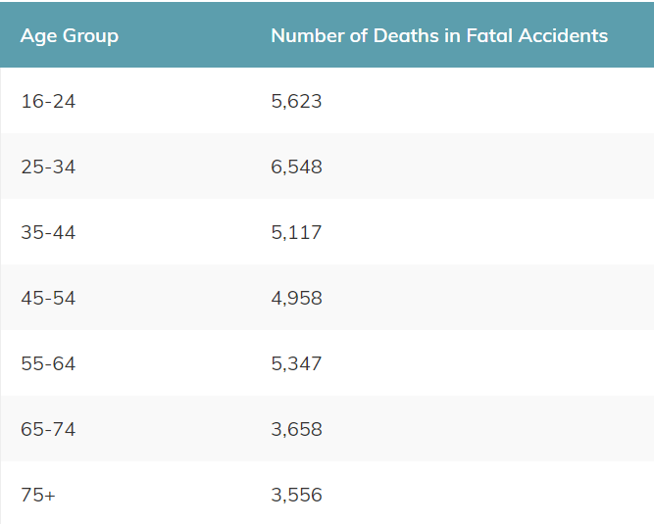
The Shape Seems Right!

Slide 9
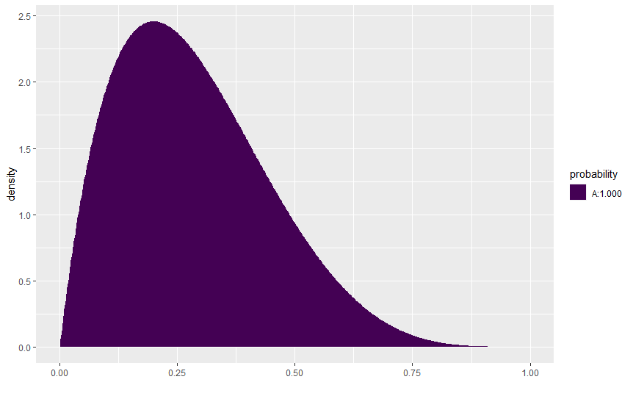
The Shape Seems Right…
LQ ⩰ 6.789435

Slide 10
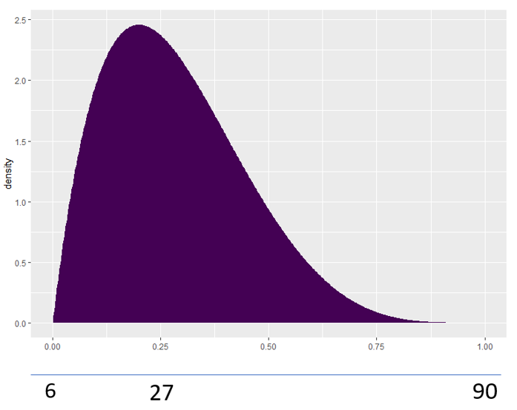
How Do We Scale the Beta Distribution?
UQ ⩰ 70.53729
LQ ⩰ 6.789435
We want the peak of the Beta distribution to resemble an age around 30 (following the online data).
Scale adjusted using a linear transformation of 6+x*84

Slide 11
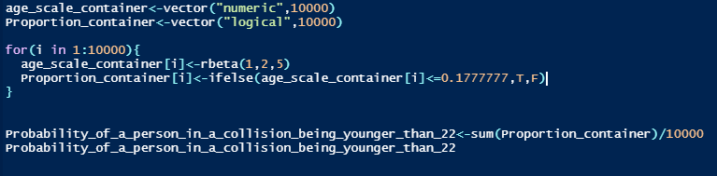
Simulation of the Probability
From our linear transformation, we get that the equivalent number of 22 in the beta scale is 0.17777777.

Slide 12
How far can you drive until you can expect to get into a car accident?
According to Esurance.com– Every 1000 miles, 1/336 chance of getting into a collision.
Geometric Distribution

Slide 13


Simulation
The average car is expected to last between 200,000 to 300,000 miles.
Car insurance Companies can now estimate when you will get into an accident based on how much you drive–which might make them want to charge more.

Slide 14
What about speeding?
According to automotive fleet and hale law firm, speeding by 10mph increases risk of accident by 31%
Using the probability from earlier (1/336).
Let’s compare how many miles it would take to get into two accidents for a speeder and non speeder.

Slide 15
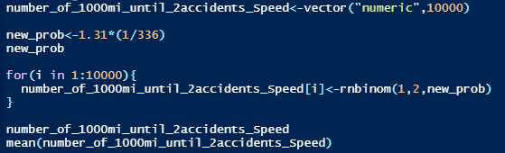
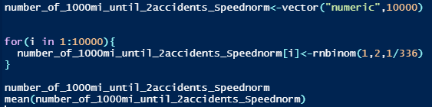
Negative Binomial Distribution.

Slide 16
What does this mean?
It took significantly less time to get into the same number of accidents.
Relevant to premiums?

Slide 17
In Summary, …
Probability of a person in a fatal car crash being under 22 (0.3).
It is expected that around every 300,000 miles you will get into a car accident.
Speeding can make a big difference.
PLEASE BE SAFE!

